Slide 1


Dual-Readout calorimetry: studies of a SiPM-based simulated readout and deep learning applications
Alessandro Villa
Anno accademico 2019/2020
Seduta di laurea magistrale del
26 marzo 2021
Relatore: Dott. Roberto Ferrari
Correlatore: Dott. Lorenzo Pezzotti
Università degli studi di Pavia
Dipartimento di fisica

Slide 2
TABLE OF CONTENTS
Future colliders
Calorimetry and the dual-readout method
Silicon PhotoMultipliers
IDEA dual-readout calorimeter simulation and SiPM signal digitisation
Deep neural network applications on image processing and particle identification

Slide 3

Future colliders

Slide 4
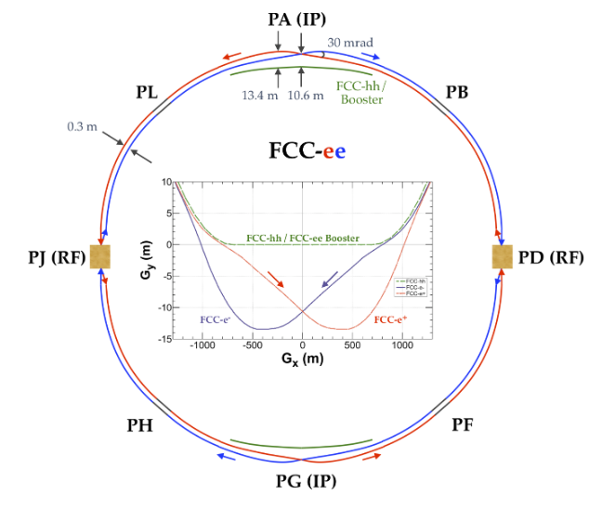
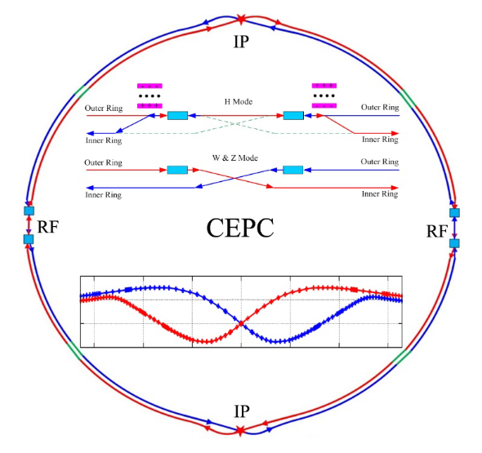
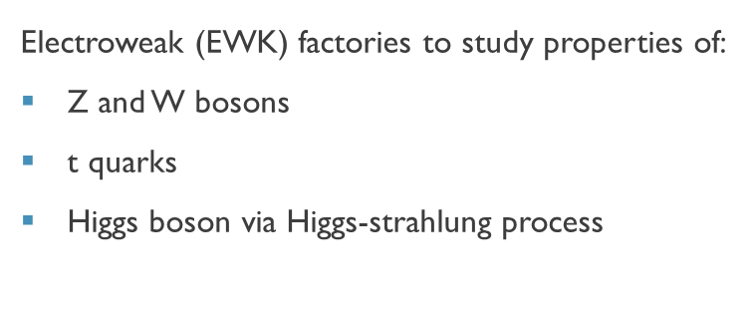
Future leptonic colliders
Electroweak (EWK) factories to study properties of:
Z and W bosons
t quarks
Higgs boson via Higgs-strahlung process
$$e^{+}e^{−}→HZ$$
EWK factory proposals:
Future Circular Collider e⁺e⁻
Circular Electron Positron Collider
Compact LInear Collider
International Linear Collider
4/32

Slide 5
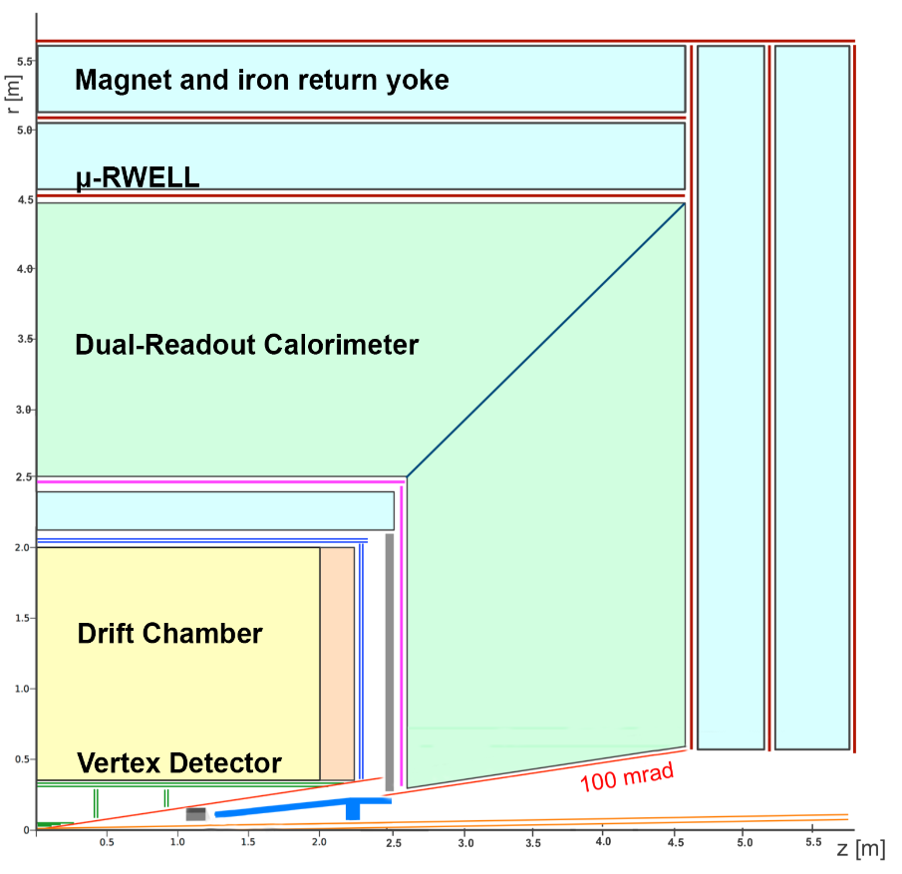
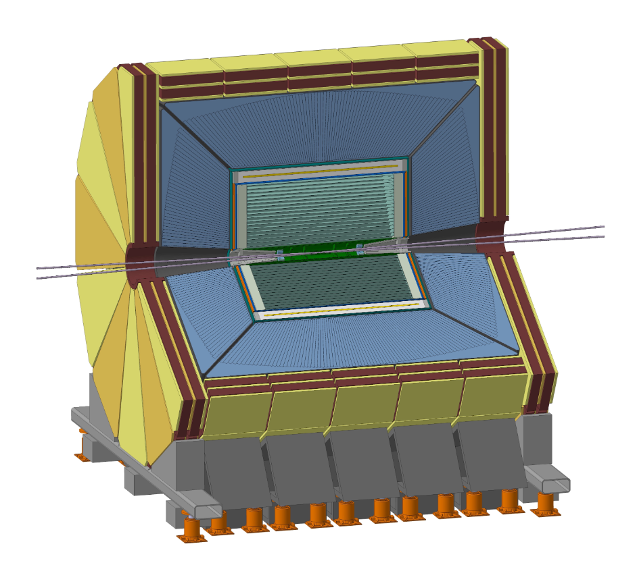
IDEA Detector Concept
General-purpose detector for future e⁺e⁻ circular colliders,
proposed at the beginning by INFN (Milano, Pavia, Pisa, Bologna and Lecce) and now supported by an international collaboration.
Included in FCC-ee and CEPC design reports.
Vertex detector
Drift chamber
Superconducting solenoid coil
Dual-readout calorimeter
Yoke and muon chambers
5/32

Slide 6
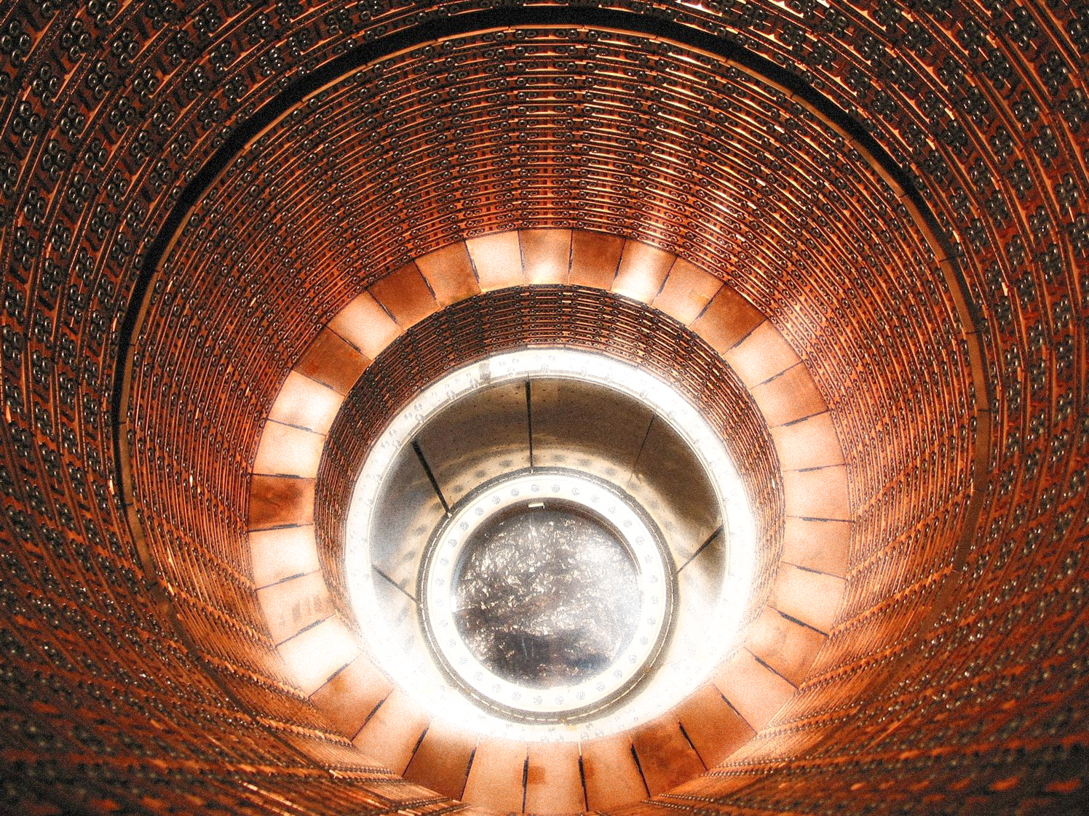
Calorimetry and the dual-readout method

Slide 7
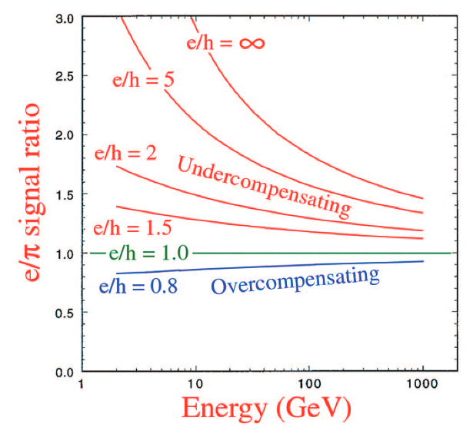
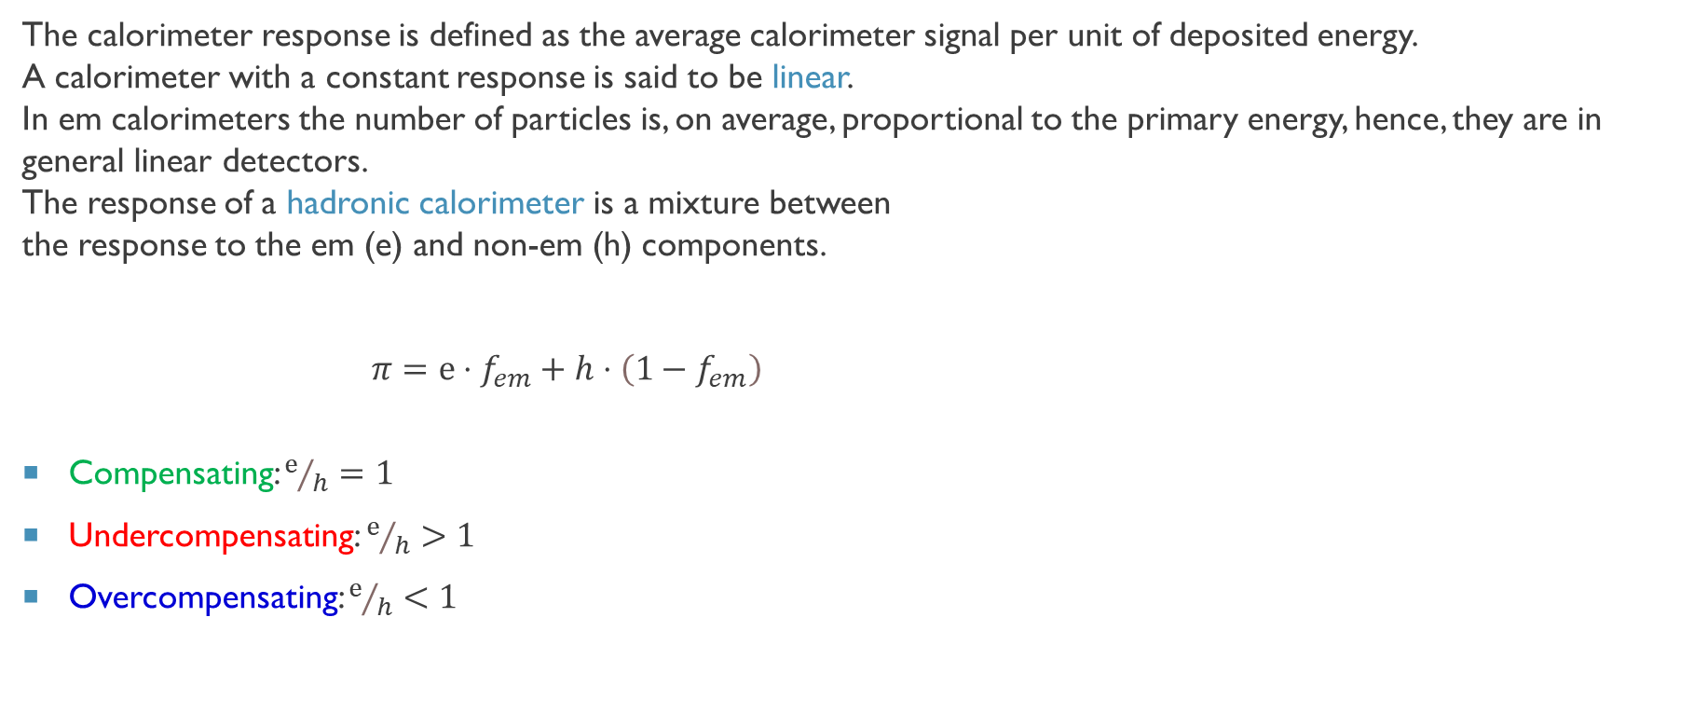
Calorimeter response
The calorimeter response is defined as the average calorimeter signal per unit of deposited energy. A calorimeter with a constant response is said to be linear. In em calorimeters the number of particles is, on average, proportional to the primary energy, hence, they are in general linear detectors. The response of a hadronic calorimeter is a mixture between the response to the em (e) and non-em (h) components.
$π=e⋅f_{em}+h⋅\left(1−f_{em}\right)$
Compensating: $ⅇ/h=1$
Undercompensating:${ ⅇ}/h>1$
Overcompensating: $ⅇ/h<1$
R. Wigmans et al. “The art of calorimetry”
DOI 10.3254/978-1-60750-630-0-31
7/32

Slide 8
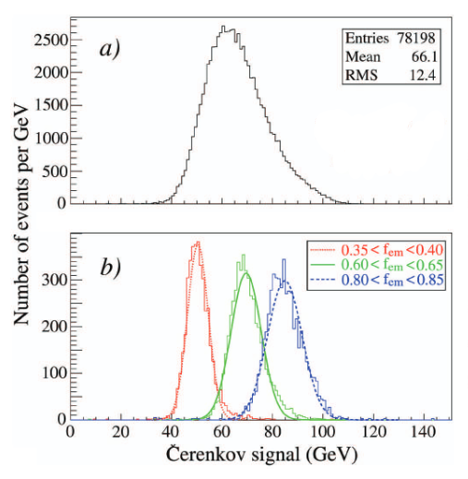
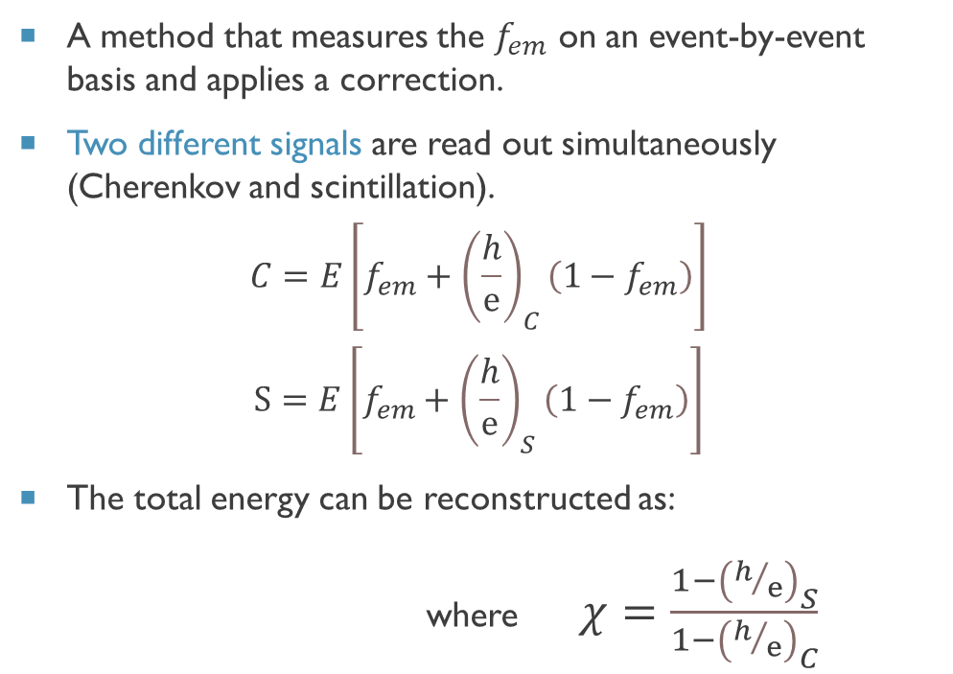
Dual-readout compensation
A method that measures the $f_{em}$ on an event-by-event basis and applies a correction.
Two different signals are read out simultaneously (Cherenkov and scintillation).
$$C=E\left[f_{em}+{\left(\frac{h}{ⅇ}\right)}_{C}\left(1−f_{em}\right)\right]$$
$$S=E\left[f_{em}+{\left(\frac{h}{ⅇ}\right)}_{S}\left(1−f_{em}\right)\right]$$
The total energy can be reconstructed as:
$E=\frac{S−χC}{1−χ}$ where $χ=\frac{1−{\left(h/ⅇ\right)}_{S}}{1−{\left(h/ⅇ\right)}_{C}}$
R. Wigmans et al. “The art of calorimetry”
DOI 10.3254/978-1-60750-630-0-31
8/32

Slide 9
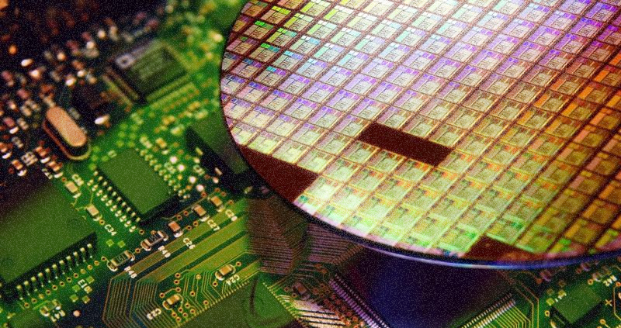
Silicon Photomultipliers

Slide 10
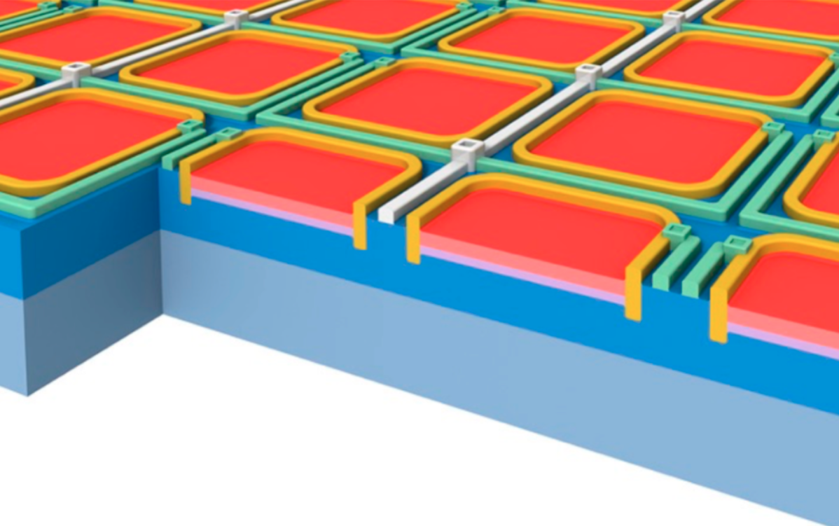
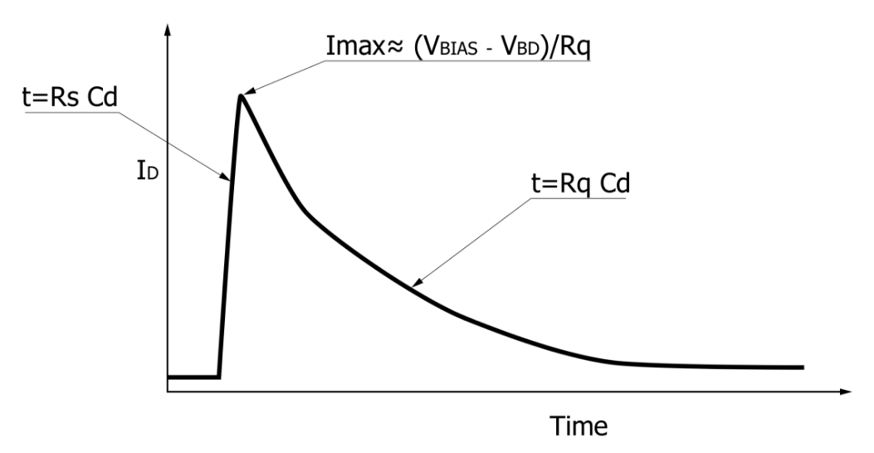

Working principle
SiPMs are high-density matrices (up to 10⁴ per mm²) of Avalanche PhotoDiodes (APDs).
APD is a p-n diode operating in the Geiger-Müller regime.
The high electric field in the depleted region allows to detect single photons through the production of an avalanche discharge.
Each APD has a blind time window after detecting a photon.
SiPMs overcome this limit connecting in parallel thousands of APDs.
$$I_{D}$$
Response time
Recovery time
10/32

Slide 11
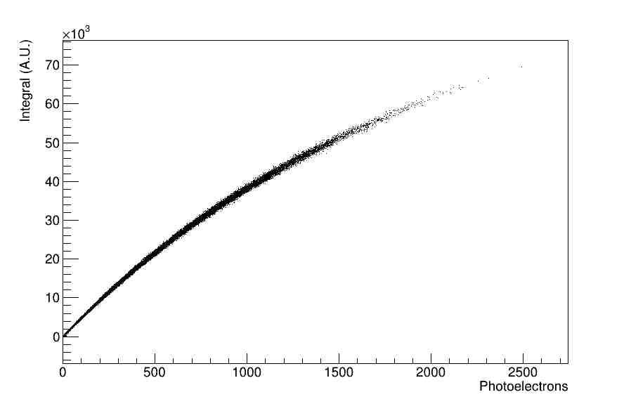
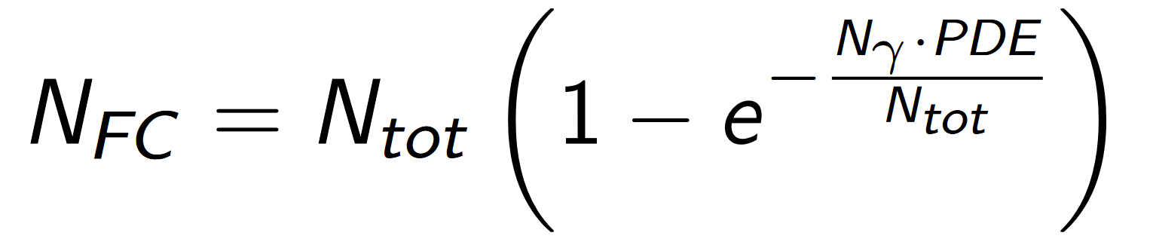
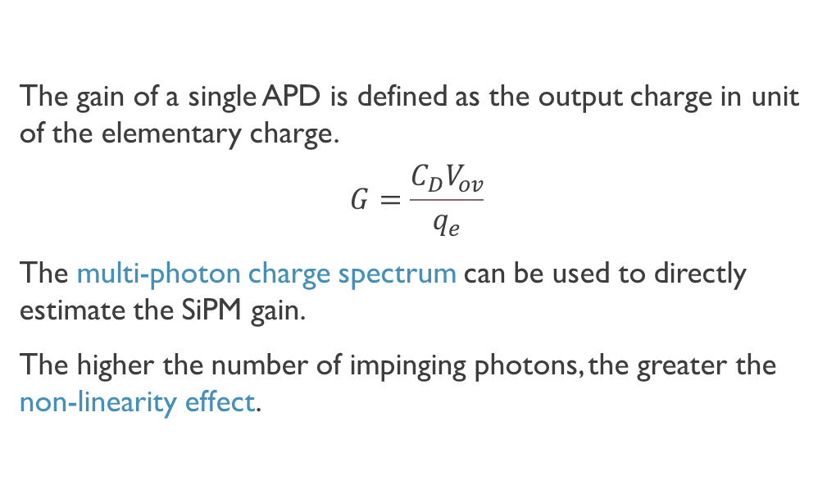
Gain and linearity
The gain of a single APD is defined as the output charge in unit of the elementary charge.
$$G=\frac{C_{D}V_{ov}}{q_{e}}$$
The multi-photon charge spectrum can be used to directly estimate the SiPM gain.
The higher the number of impinging photons, the greater the non-linearity effect.
11/32

Slide 12
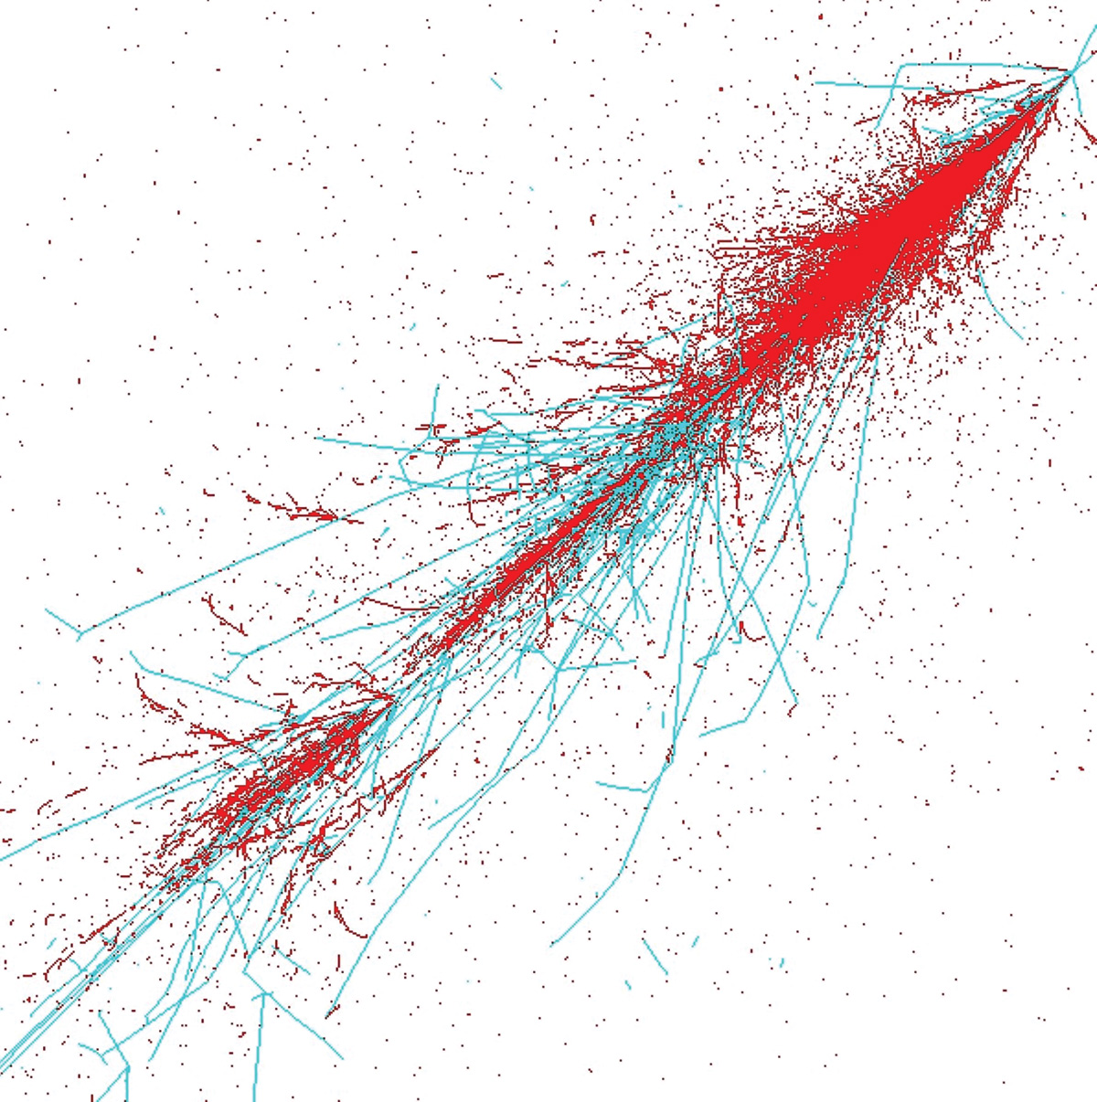
IDEA dual-readout calorimeter simulation and SiPM signal digitisation

Slide 13
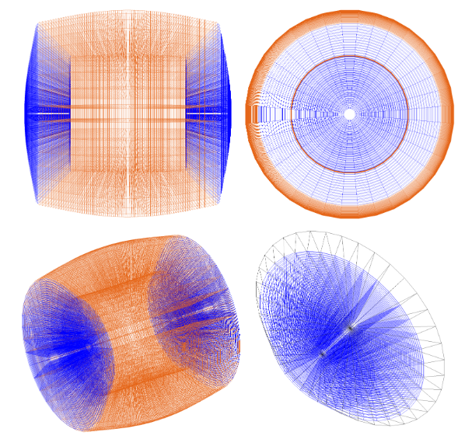
IDEA dual-readout calorimeter
Tower-based, longitudinally unsegmented, fully projective, fibre-sampling calorimeter.
Cylindrical symmetry characterised by a barrel and two end-cap regions.
2 m long copper-based towers.
Tower segmentation: Δθ = 1.125°, Δφ = 10.0°.
The coverage in θ is down to ≈0.1 rad.
Coded in C++ using the GEANT4 toolkit.
13/32

Slide 14
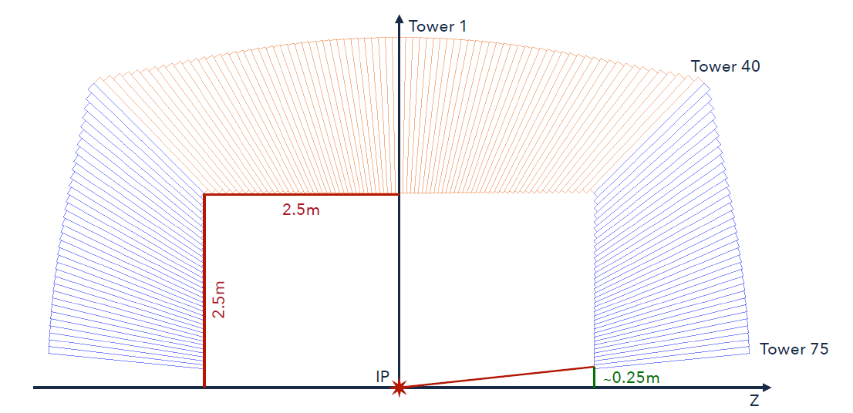
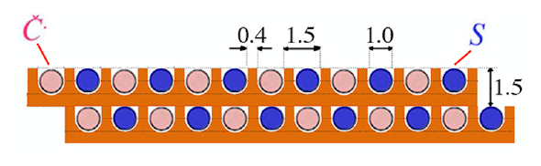
IDEA dual-readout calorimeter
36 rotations of the slice structure around the beam axis.
Towers in barrel: 40⨉2⨉36 = 2880
Towers per endcap: 35⨉36 = 1260
Towers are filled with two types of optical fibres for Cherenkov (C) and Scintillating (S) light production (total of ≈130⨉10⁶ fibres).
Each fibre is coupled to a dedicated SiPM to achieve:
Excellent spatial resolution
Excellent angular resolution
Excellent shower shape sensitivity for particle ID
14/32

Slide 15
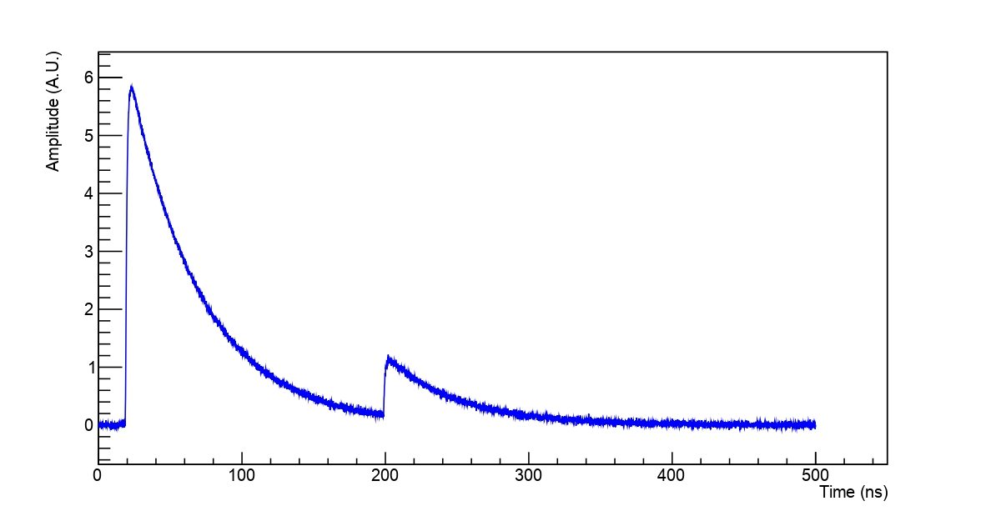
Sipm digitisation software
The SiPM digitisation software can provide useful features such as:
Peak height
Charge integral
Time of Arrival
Time over Threshold
Time of Peak
It can also provide a digitised waveform as output from each SiPM.
Noise
15/32

Slide 16
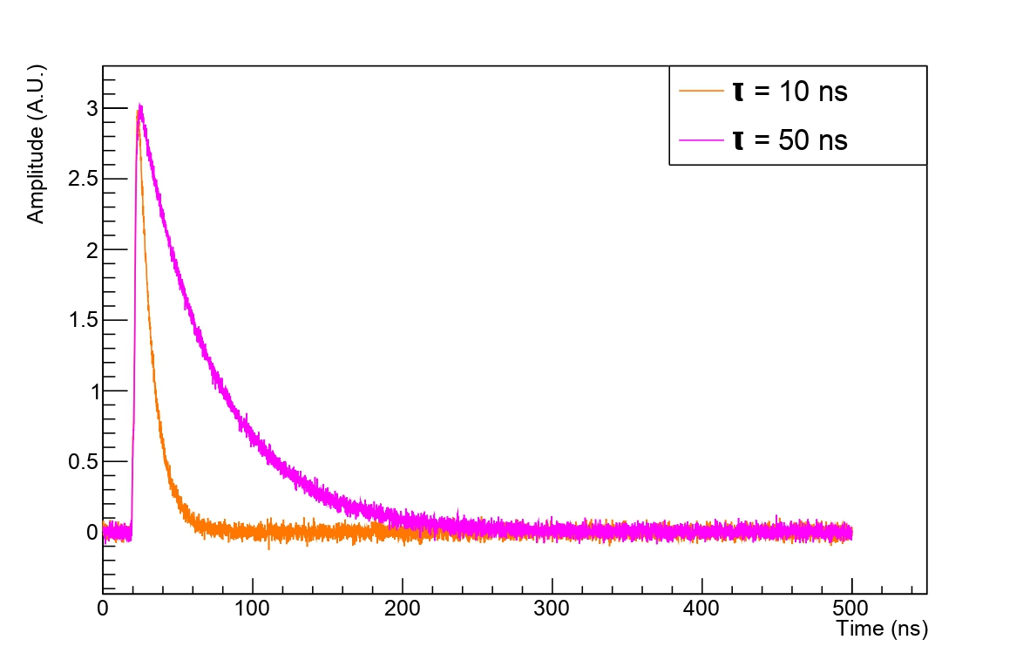
Different configurations
Most of the SiPM parameters can be easily modified.
Signal duration: 500 ns
Sampling: 0.1 ns
SiPM Size: 1×1 mm²
Cell Size: 25×25 μm²
Dark Count Rate: 200 kHz
CrossTalk: 1%
After Pulse: 3%
Decay Time Constant: 10 or 50 ns
Rise Time Constant: 1 ns
Integration Start Time: 5 ns
Integration Time Window: 300 ns
16/32

Slide 17
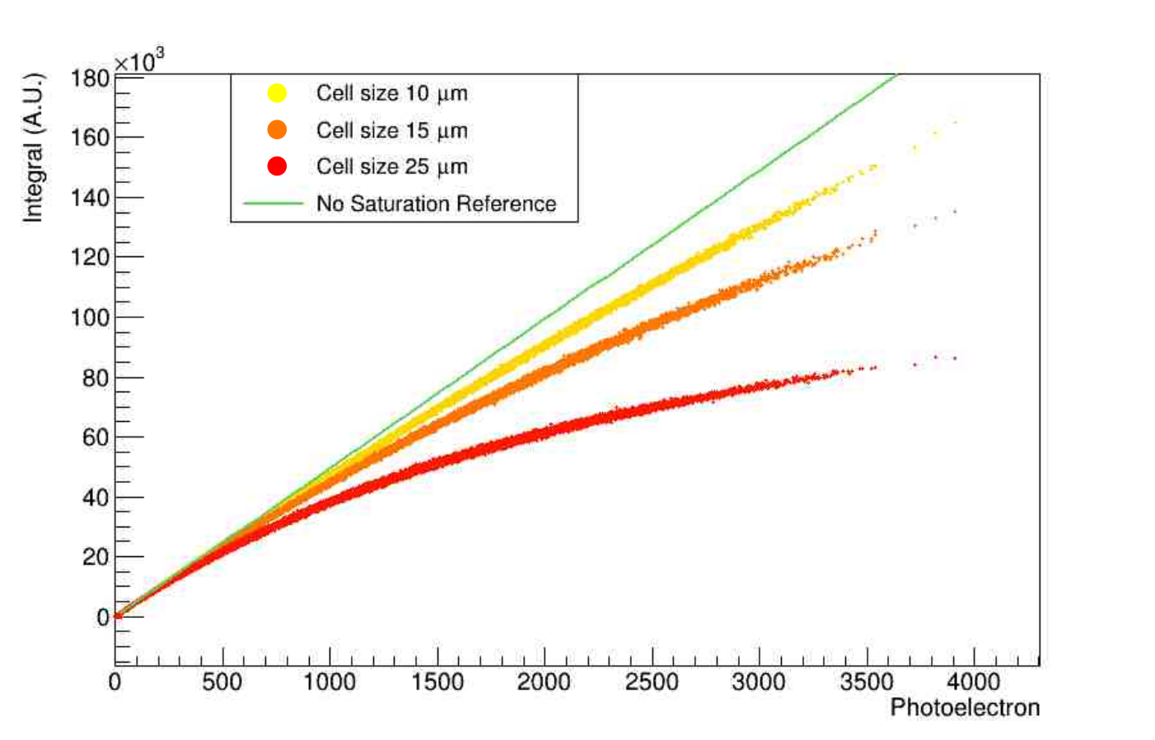
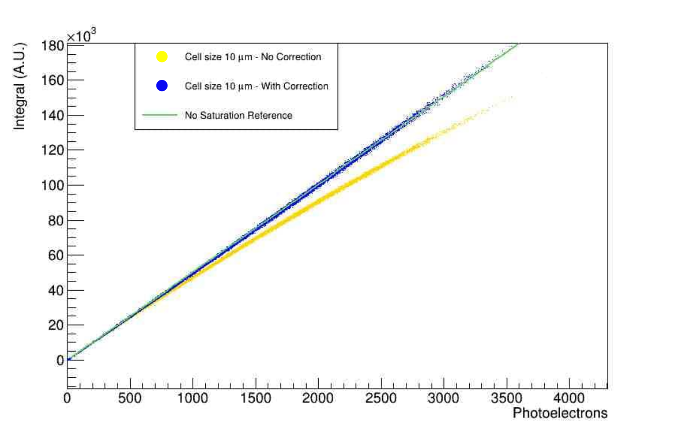
Sipm non-linearity
10000 events are considered, using a Light Yield of ≈ 400 pe/GeV for scintillation and ≈ 100 pe/GeV for Cherenkov.
An analytical correction has been applied through the law:
40 GeV electrons
Cell size 10 μm
Cell size 15 μm
Cell size 25 μm
Linear reference
No correction
With correction
Linear reference
Scintillation signal
Scintillation signal
17/32

Slide 18
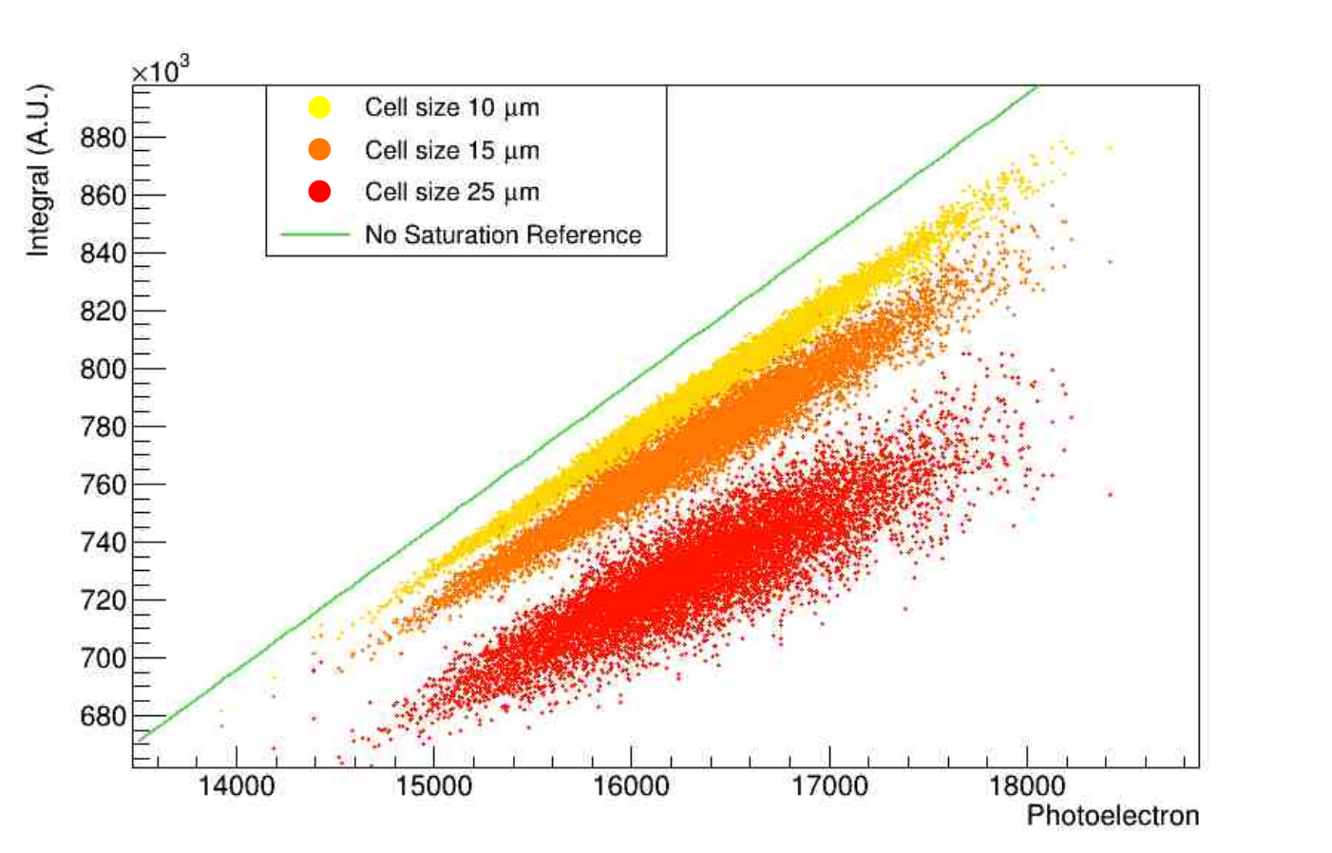
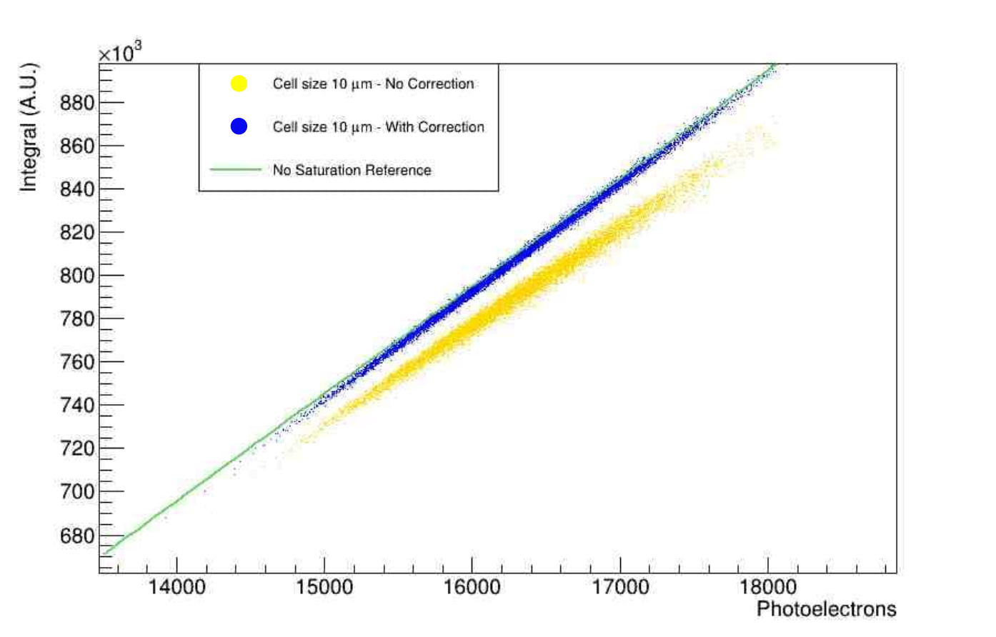
Sipm non-linearity – impact on event reconstruction
Adding, event by event, the charge integral and the corresponding photoelectron numbers, we can study the impact of non-linearity on the energy reconstruction task.
40 GeV electrons
Cell size 10 μm
Cell size 15 μm
Cell size 25 μm
Linear reference
No correction
With correction
Linear reference
Scintillation signal
Scintillation signal
18/32

Slide 19
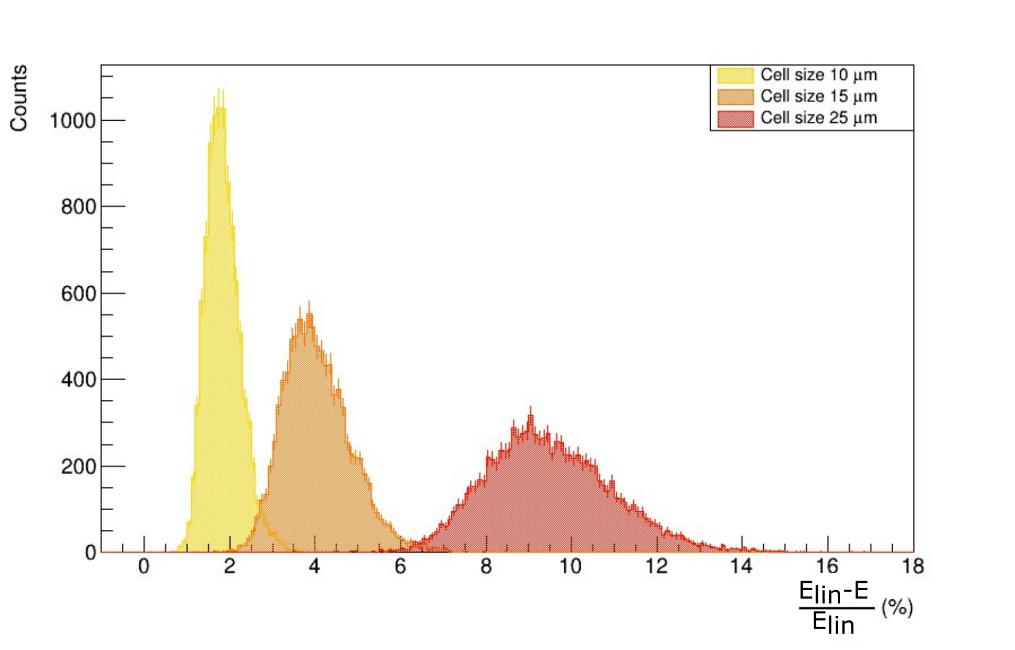
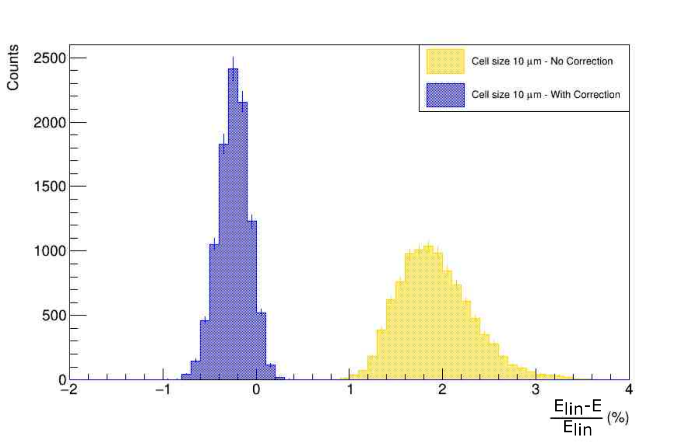

Sipm non-linearity – impact on energy reconstruction
Comparing each event integral to the linearly extrapolated integral with the formula $\frac{E_{lin}−E}{E_{lin}}$
Distribution of the discrepancy with different cell size and applying the analytical correction are obtained.
40 GeV electrons
Scintillation signal
Scintillation signal
19/32

Slide 20
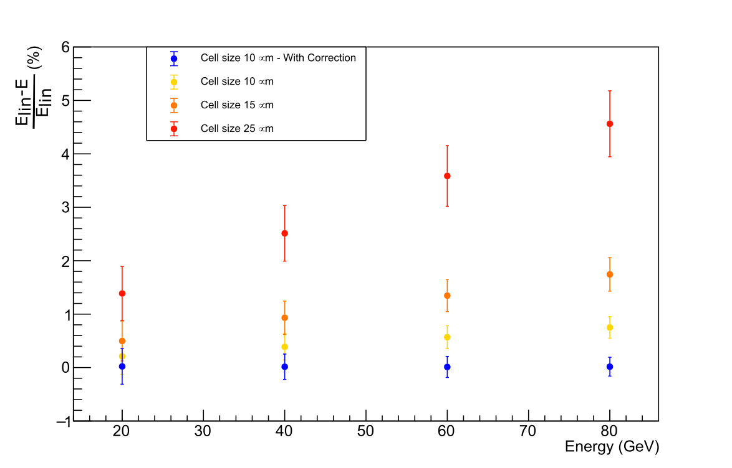
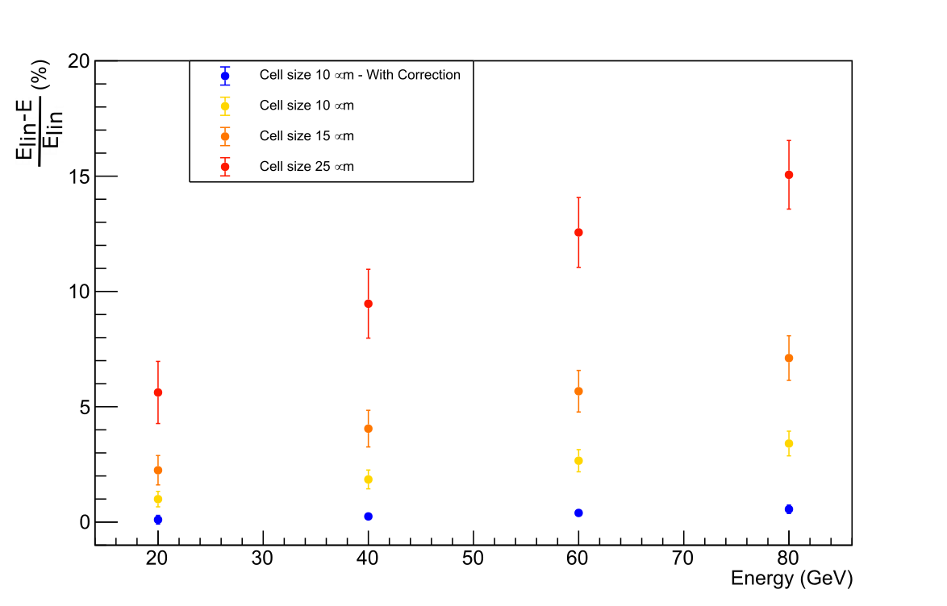
OVERALL linearity
We performed the same process with electrons of different energies (20 − 40 − 60 − 80 GeV)
and distinguishing the type of signal (Cherenkov or Scinitillation).
Cherenkov signal
Scintillation signal
With the analytical correction, the non-linearity can be brought well below 1% in both C and S signals.
Other studies on time features and energy resolution have been performed.
20/32

Slide 21

Deep neural network applications on image processing and particle identification

Slide 22
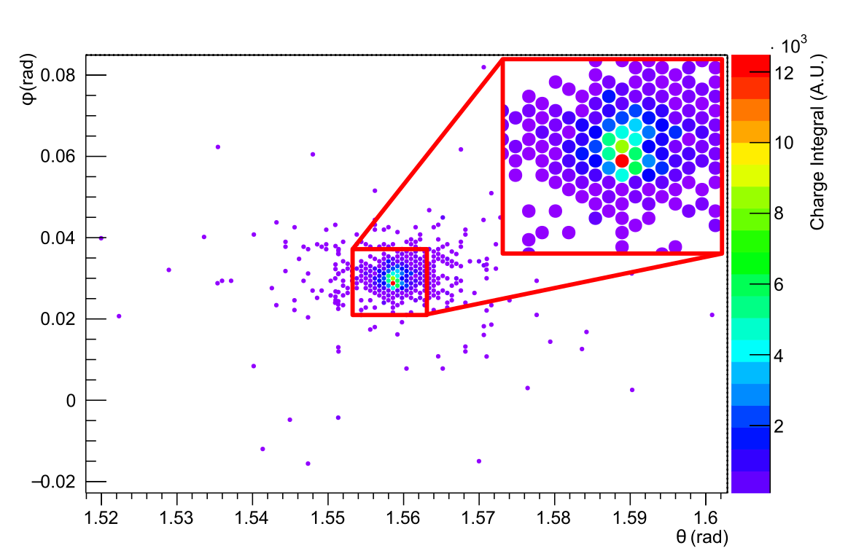
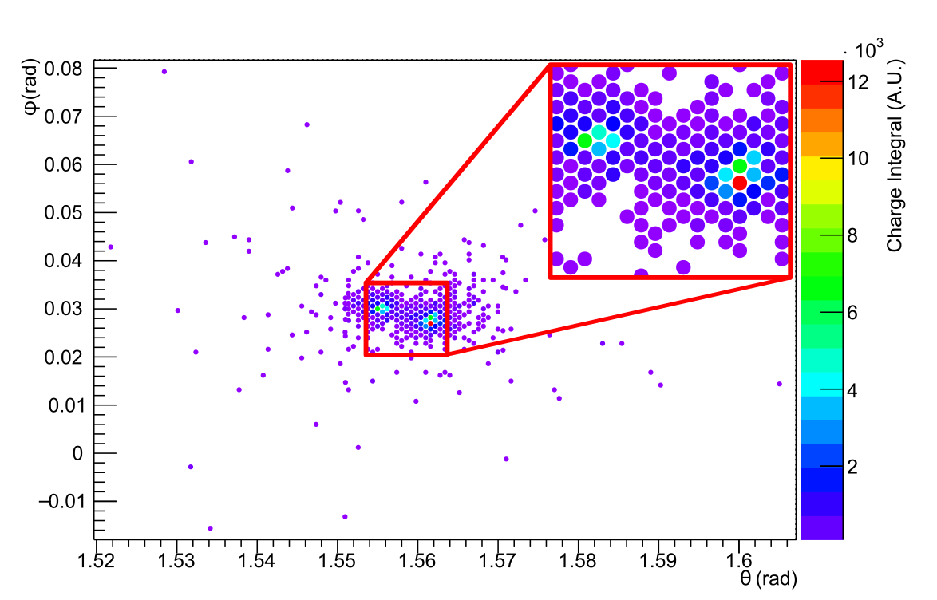
Deep learning task
The task is to train a neural network to recognise and distinguish neutral pions and photons analysing the released-energy spatial distribution.
Photon
Neutral pion
Cherenkov signal
Cherenkov signal
22/32

Slide 23
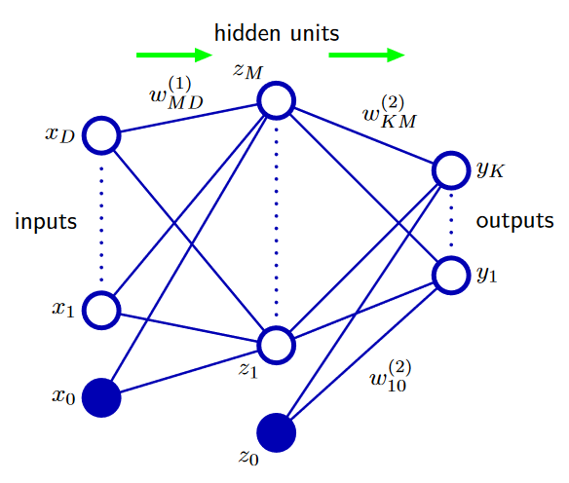
Neural-network basics
Neural Networks are neural-inspired non-linear models consisting in a group of artificial neurons or nodes interconnected to each other and grouped in layers.
A mathematical structure, where each neuron has an activation degree and each edge is identified by weights and biases, supports the modelling.
Once the neural network is set up a training process starts using a large dataset of correctly labelled input data.
During the training, weights and biases are constantly modified to adapt the output to be as closer as possible to the correct label minimising an error function.
C.M. Bishop, “Pattern recognition and machine learning”, Springer, 2006
23/32

Slide 24
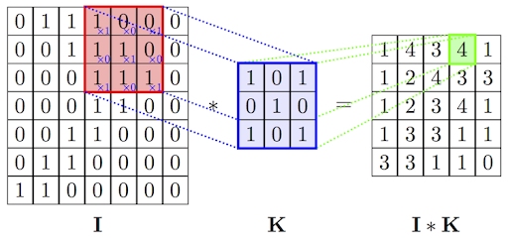
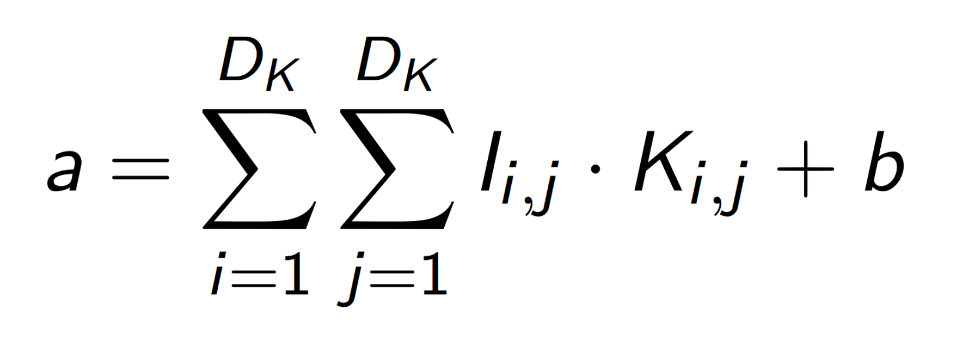
Neural-network basics - Convolution layer
A convolution is an application of a filter to an input that results in an activation.
This application to the whole input data results in a feature map indicating locations and intensities of detected features.
Mathematically the activation value is:
Where D_{K} is the dimension of the kernel
and b is the bias value.
24/32

Slide 25
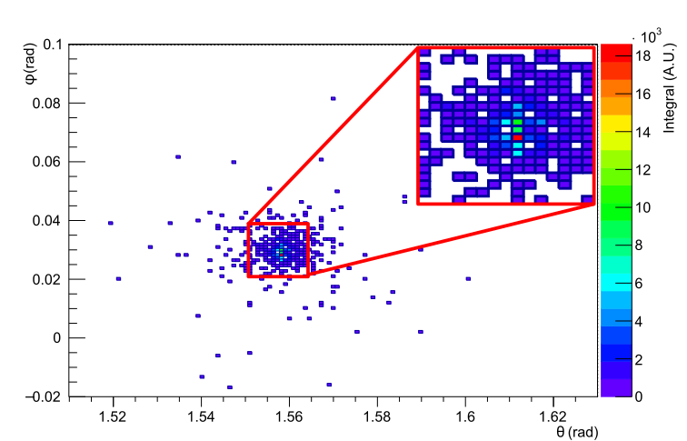
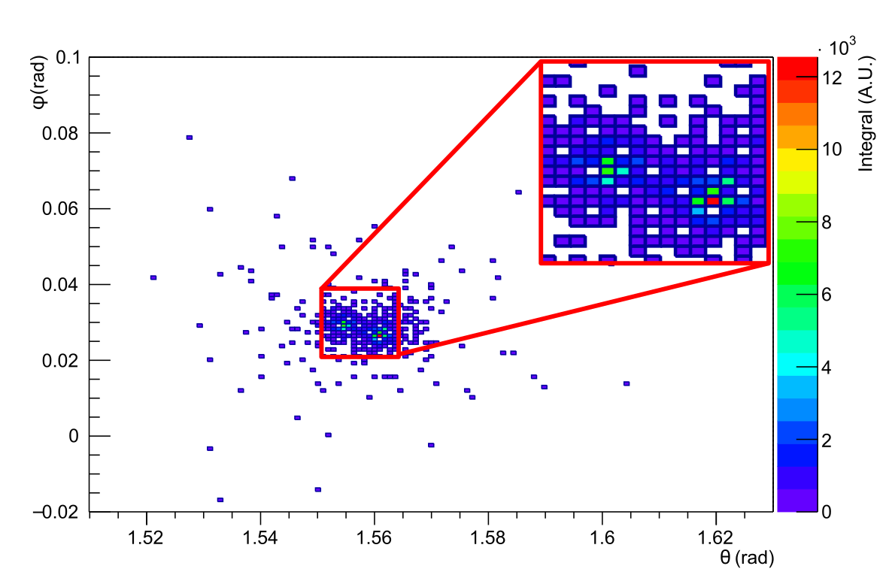
Data preparation
The input of a Convolutional Neural Network (CNN) has to be a matrix with small values ranging between 0 and 1. A matrix representation of the data is obtained through a binning. For each event two matrices of the same size are obtained from Cherenkov and scintillation signals.
Photon
Neutral pion
Cherenkov signal
Cherenkov signal
25/32

Slide 26
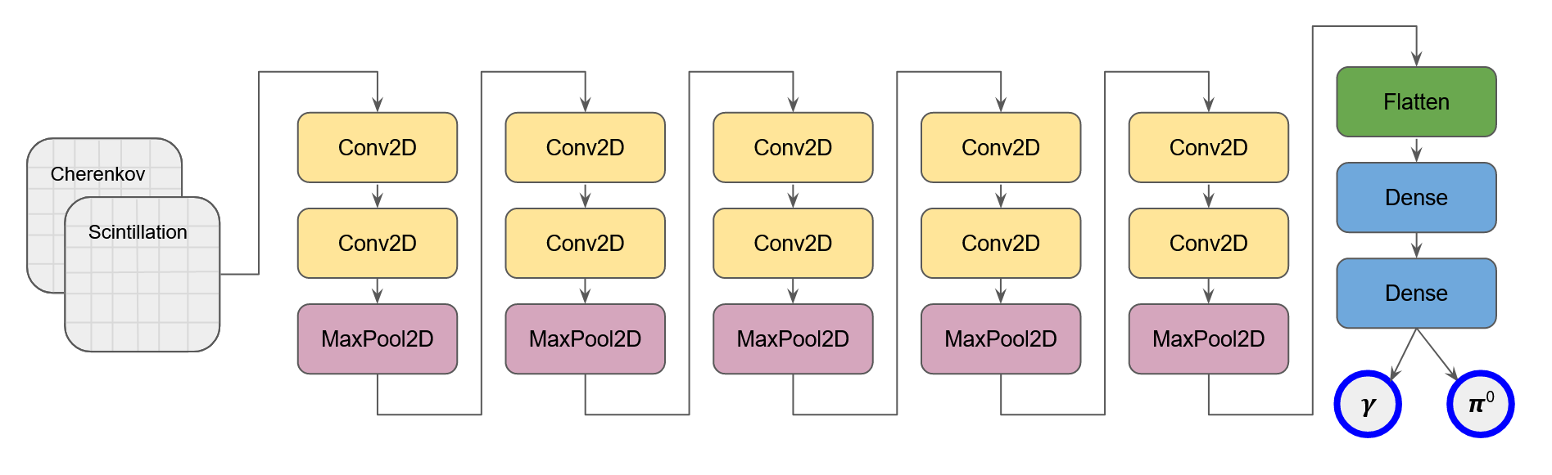

Neural-network structures - VGG Network
The VGGNet structure is a neural network concept introduced in 2015.
The structure consists in groups of convolutional layers with small kernel size.
These approximate larger filters with higher trainable parameters (i.e. more pattern recognition possibilities).
Karen Simonyan and Andrew Zisserman,
“Very Deep Convolutional Networks for Large-Scale Image Recognition”, arXiv:1409.1556v6, 2015
26/32

Slide 27
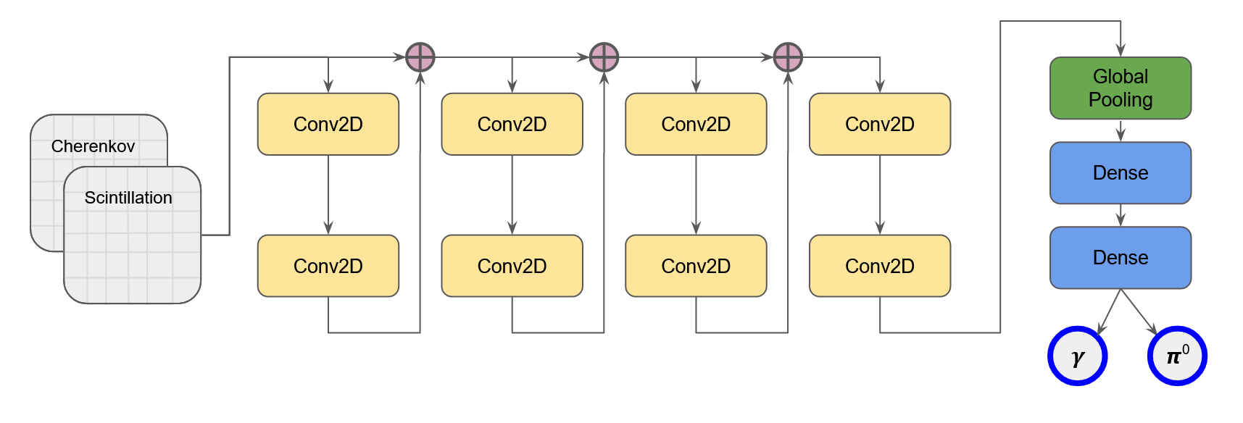
Neural-network structures - Residual Network
ResNet is another innovative concept of CNN introduced in 2016.
The structure is composed by small-kernel convolutional layers, as in VGGNet.
They are divided in residual blocks and the input of each block is the sum of the input and the output of the previous block.
Kaiming He et al.,
“Deep Residual Learning for Image Recognition”,
arXiv:512.03385v1, 2016
27/32

Slide 28
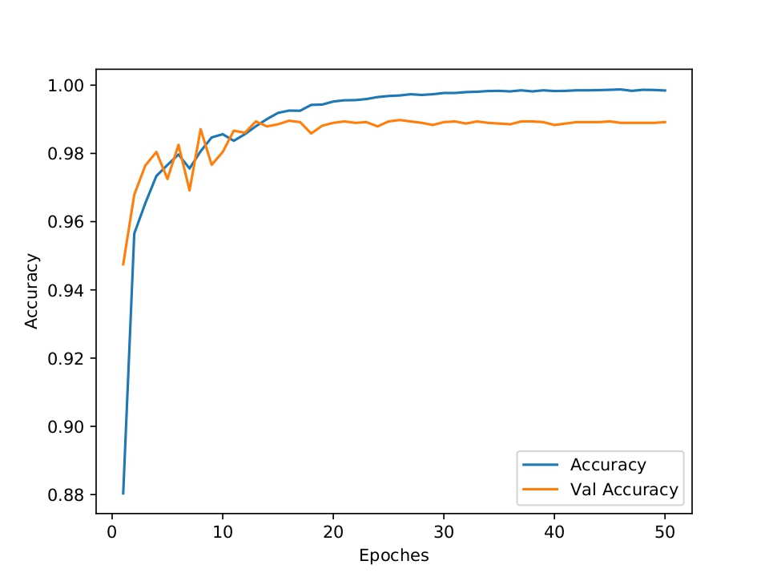
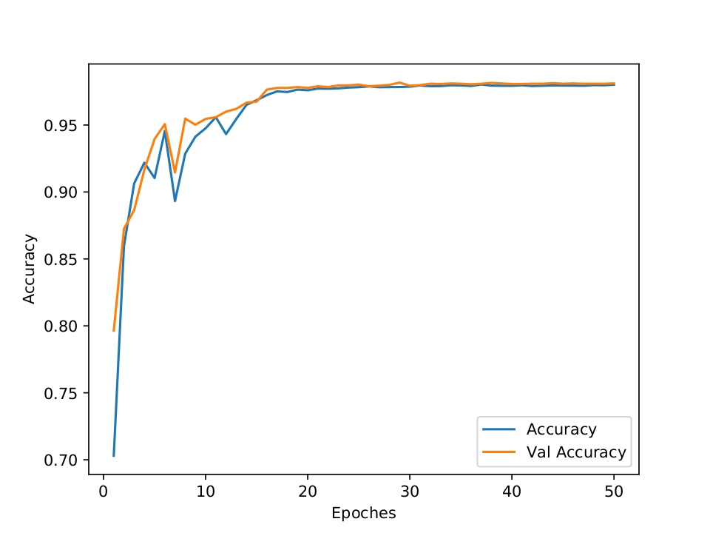
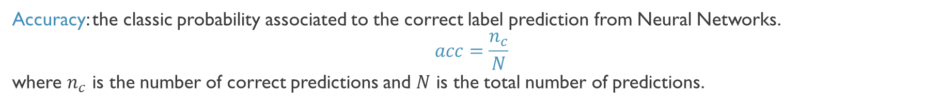
Neural-network results - ACcuracy
Accuracy: the classic probability associated to the correct label prediction from Neural Networks.
$$acc=\frac{n_{c}}{N}$$
where $n_{c}$ is the number of correct predictions and $N$ is the total number of predictions.
VGGNet
ResNet
Training set
Validation set
Training set
Validation set
Epochs
Epochs
28/32

Slide 29
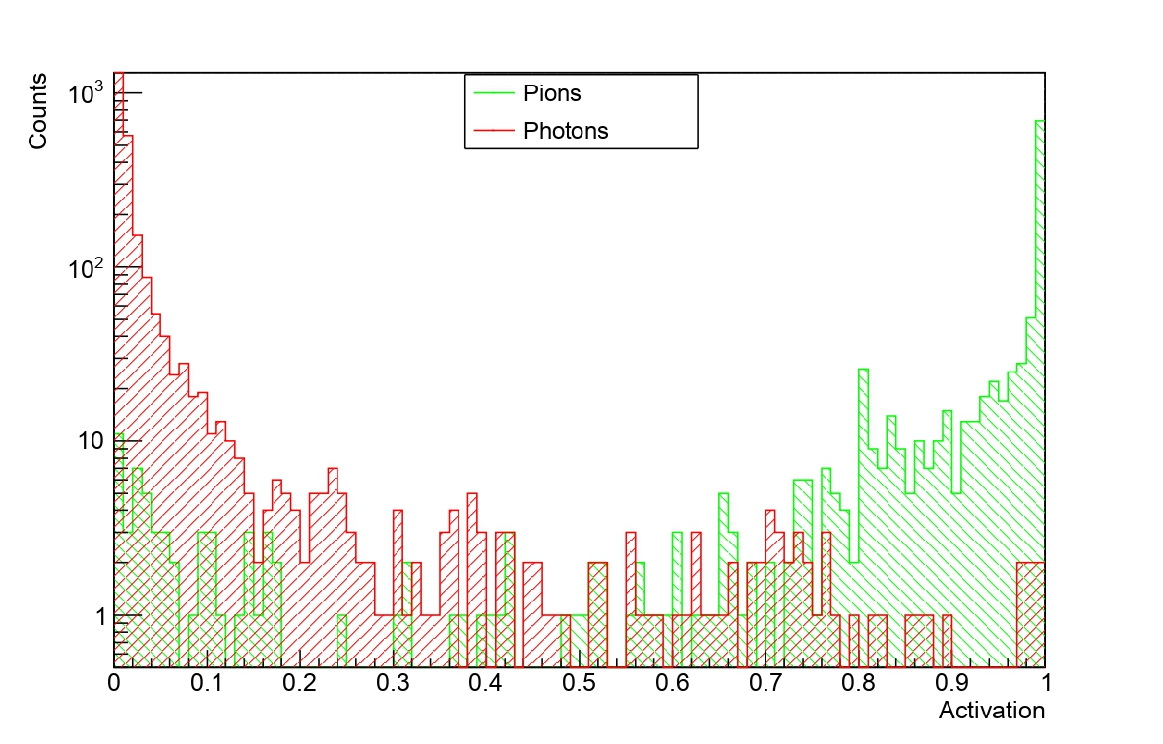
ROC curve
Distribution of activation values associated to the neuron labelling π⁰ events.
Two groups are separated depending on the true particle producing the analysed event.
The ideal distribution have only two bins populated:
The 0-value bin for photon events
The 1-value bin for neutral pion events
In 2-class classification tasks, the threshold to consider a neuron activated is set at 0.5 as default (in Keras library).
1-80 GeV
VGGNet
29/32

Slide 30
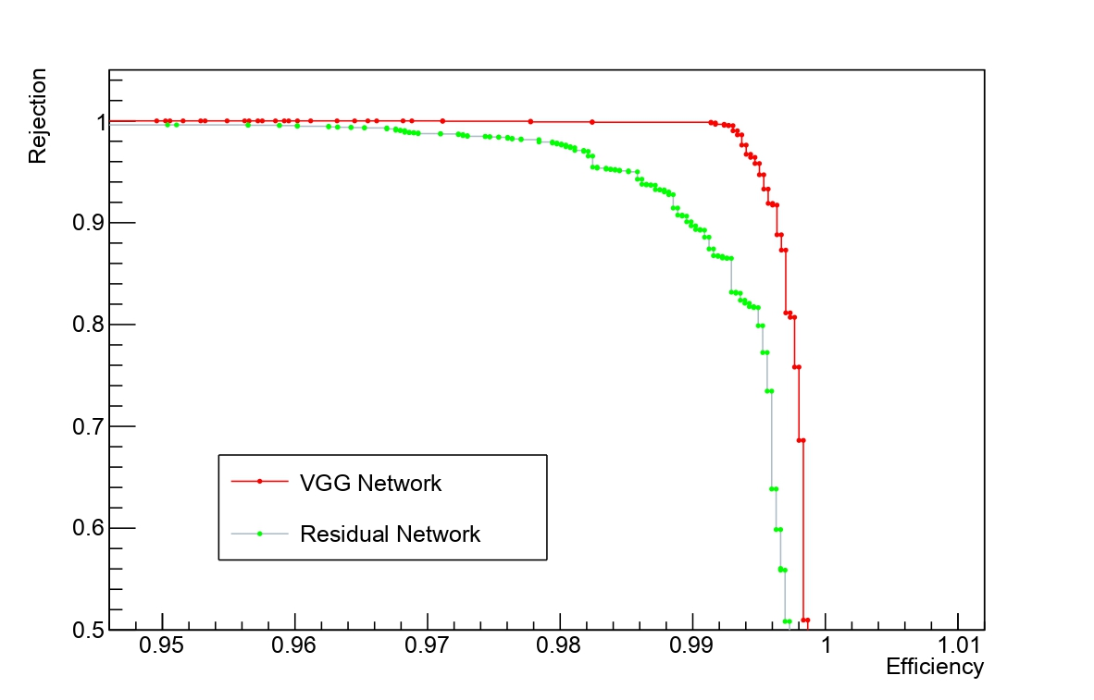
ROC results
Changing the threshold value, the ROC curve is populated.
Receiver Operating Characteristic curve:
x axis: efficiency in detecting a neutral pion
y axis: rejection of photon events
The ideal ROC curve passes on the point (1,1) that corresponds to the perfect efficiency and rejection conditions.
IDEAL ROC CURVE
The AUC (Area Under the ROC Curve) quantifies the quality of a NN (1 is the ideal value)
VGGNet AUC: 0.9982 ResNet AUC: 0.9957
30/32

Slide 31
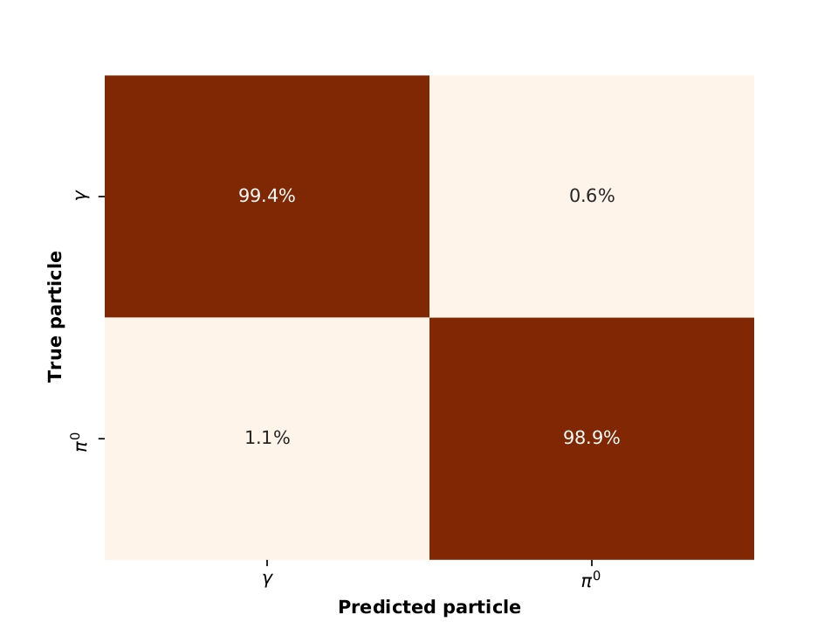
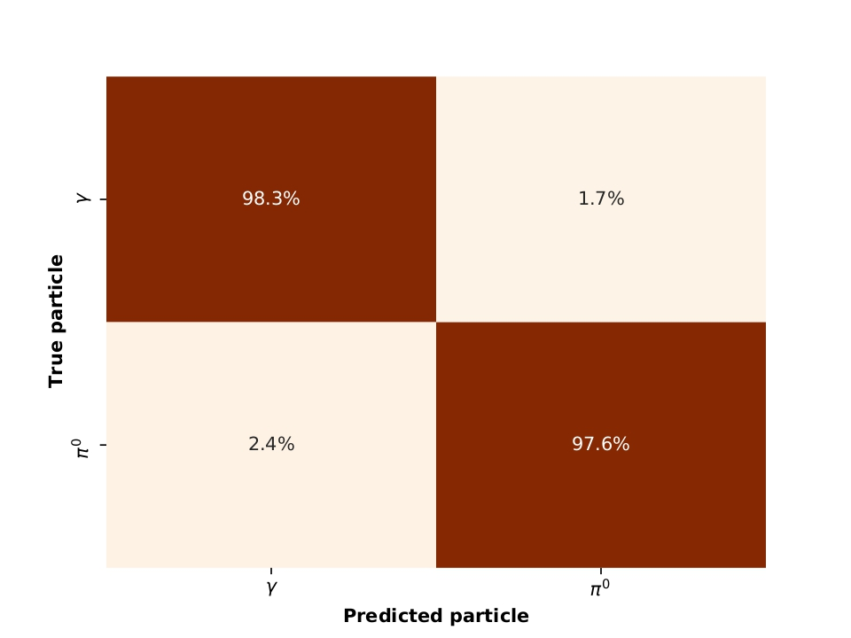
Neural-network results – confusion matrix
Confusion matrix: matrix showing the percentage probability of a neural network in identifying categories.
Values are normalised with respect to true particle label (rows). Threshold set at 0.5 as default.
VGGNet
ResNet
31/32

Slide 32
SUMMARY
Studies of the impact of SiPM-based readout on IDEA calorimeter simulation
Consistency of timing features
My procedure to restore lineary reaching non-linearity well below 1% in the energy range 20 – 80 GeV
Minimal loss on energy resolution
Development and application of Convolutional Neural Networks on data from the simulation chain
Pioneering particle ID application to photons and neutral pions of 40 GeV
Extension of the application on the energy range 1 – 80 GeV with excellent accuracy results over 97%
32/32

Slide 33
backup

Slide 34
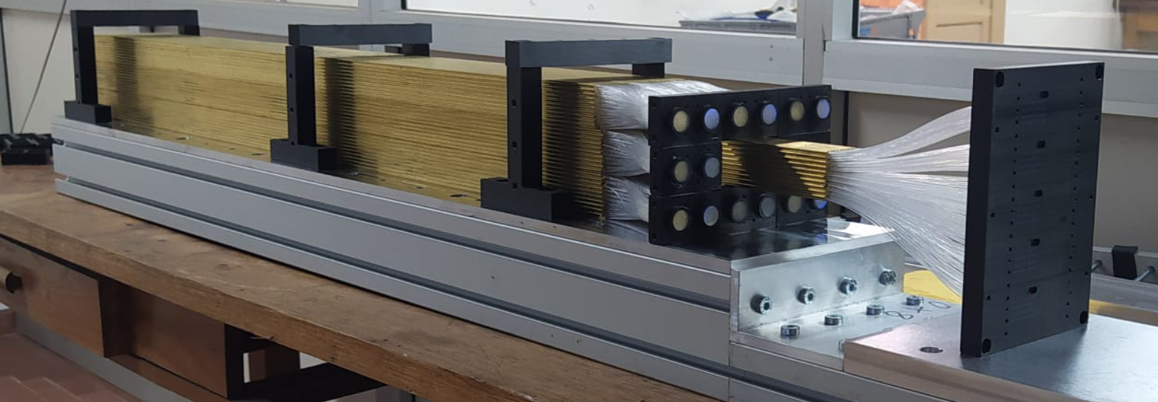
IDEA dual-readout calorimeter
Tower-based, longitudinally unsegmented, fully projective, fibre-sampling calorimeter.
Composed by an absorber (brass) and two active media (optical fibres).
Each optical fibre of the central core is read out by a single Silicon PhotoMultiplier.
Advantages in terms of spatial and angular resolution, removing the limitations arising from a readout driven by the tower dimension.

Slide 35
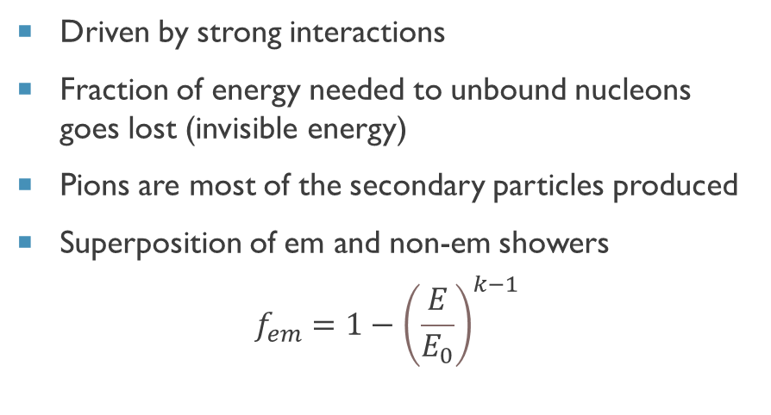
Shower principles
Electromagnetic shower
Hadronic shower
Produced by electrons, positrons or photons carrying energy of at least 1 GeV
Longitudinal development measured in radiation lenght
Transverse development measured in Molière radius
Driven by strong interactions
Fraction of energy needed to unbound nucleons goes lost (invisible energy)
Pions are most of the secondary particles produced
Superposition of em and non-em showers
$$f_{em}=1−{\left(\frac{E}{E_{0}}\right)}^{k−1}$$

Slide 36
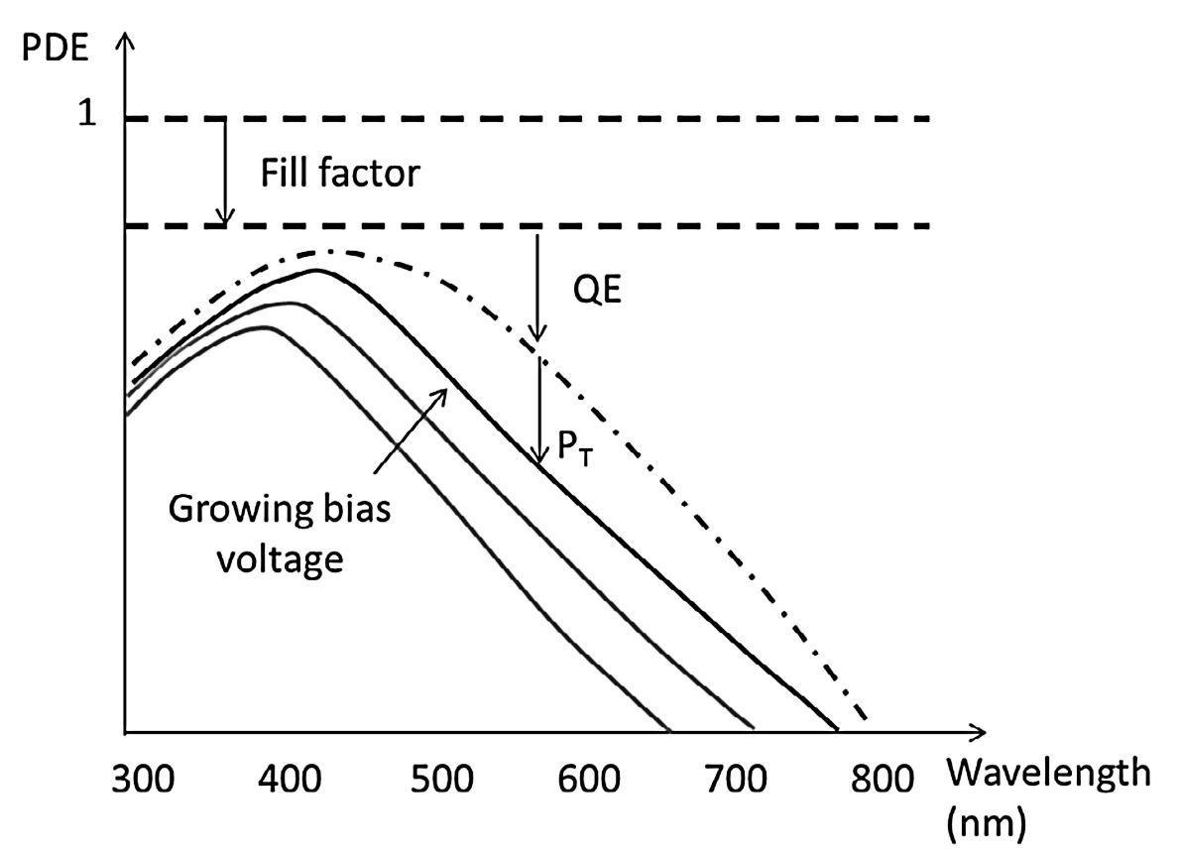

Sipm PHOTON DETECTION EFFICIENCY (PDE)
PDE is the probability of producing a signal by the SiPM when it is fired by a single photon.
The ratio of the number of fired cells that generate a signal (N_{FC}) and the total number of photons hitting the detector (Nγ).
$$PDE=\frac{\left\langle N_{FC}\right\rangle }{\left\langle N_{γ}\right\rangle }=FF×QE\left(λ\right)×P_{t}\left(λ,V_{0v},T\right)$$
Fill factor: the probability that a photon impinging the SiPM traverses the active region.
Quantum efficiency: the probability that an impinging photon generates a pair of carriers.
Avalanche triggering probability: the probability of a carrier to produce an avalanche.

Slide 37

Sipm Noise sources
When a SiPM is powered up, at least three noise sources are present.
Noises can be distinguished in two categories: primary noise and correlated noise.
Dark Count Rate
Afterpulse
Optical Cross-Talk

Slide 38


Energy resolution
Calibration at the electromagnetic scale (40 GeV electron) applying a 1.5pe-suppression.
10000 events with single 40 GeV electrons produce the energy distributions below (shifted for their mean value).
Two distributions for each channel are obtained, with and without the SiPM digitization.
Cherenkov signal
40 GeV electrons
Scintillation signal
40 GeV electrons
Energy – True energy (GeV)
Energy – True energy (GeV)

Slide 39




Energy resolution
We performed a Gaussian fit over the distributions at different electron energies (5 – 20 − 40 − 60 − 80 GeV)
and distinguishing the type of signal (Cherenkov or Scinitillation).
At this stage, the impact of the SiPM digitisation seems to be minimal.
Cherenkov signal
Scintillation signal
$$\frac{σ}{E}=\frac{21.01\%}{\sqrt{E}}⊕0.386\%$$
$$\frac{σ}{E}=\frac{18.97\%}{\sqrt{E}}⊕1.677\%$$

Slide 40



Neural-Network results - loss
Loss function: the Neural Network attempts to minimise this function modifying weights.
A common choice in classification tasks is the cross-entropy error function: $−Σ_{i}p_{i}\log{q_{i}}$
where $p_{i}$ is the true probability for each label and $q_{i}$ is predicted probability of the same label.
Training set
Validation set
Training set
Validation set
VGGNet
ResNet
Epochs
Epochs
19/25

Slide 41


Roc on different energy ranges
The validation dataset has been divided in four subsamples concerning different energy ranges.
The ROC curves have been produced on these subsamples to valuate the NN performances at different energies.
The NNs do not have performances extremely different changing the energy range.
VGGNet
ResNet

